Slide 1


Slide 2
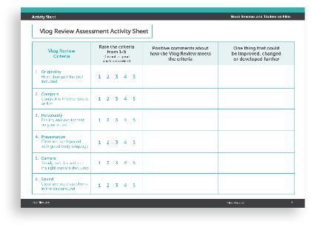
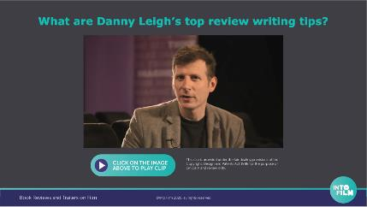
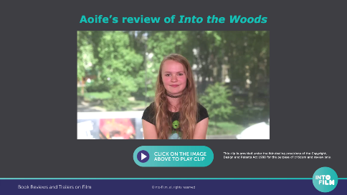
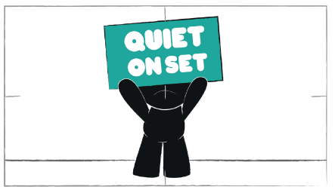
Activity 1: Vlog Review
Notes:
This activity relates to slides 3 to 16 in this PowerPoint presentation and should take around 60 minutes to complete
LEARNING OBJECTIVES
To understand the basics of creating a film
To express thoughts and feelings on camera
To plan, execute and reflect on their own films and those of others
YOU WILL NEED
Vlog Review Assessment activity sheet (slide 16 or PDF page 3)
Tablets or cameras
Tripod or a constructed cardboard tripod https://www.intofilm.org/resources/1217

Slide 3
What is a review?
A review is an opinion that comments on how good or bad a book, film, play, or other work of art is.
Telling a friend
Film review
Book review
TV programme review
Game review
Music review
Theatre review
Blog review
Website review
How many
did you
think of?
Notes:
Ask the question and then click to reveal a definition and some examples.

Slide 4

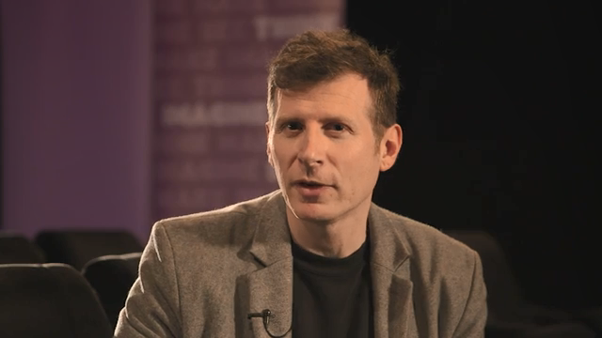
What are Danny Leigh’s top review writing tips?
Notes:
This is a clip from an interview with the film critic Danny Leigh and he gives his five top tips for writing a good film review. Ask learners to listen carefully for his advice.
A summary of Danny Leigh’s top tips are on the next slide.

Slide 5
Five things to include in your review
Be original
Elaborate include more than just the plot
Compare and contrast with other films and add explanations
Make it personal explain how it made you feel
Be excited by the film/book and /or your opinion
Notes:
This is a summary of Danny Leigh's top tips for review writing.
Extension Activity: you could research other professional resources online and see if they followed Danny’s advice.

Slide 6
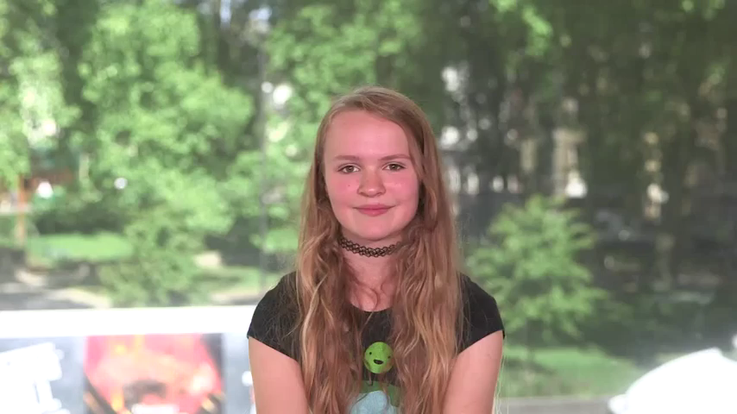
Aoife’s review of Into the Woods
Notes:
Watch the review of the film Into the Woods by Aoife, an Into Film Young Reporter.
As they watch it, children should see if she included all of Danny Leigh’s advice within it. You may wish to play the clip more than once to help with this. Consider what could be done to improve Aoife’s review.

Slide 7
Planning your review!
What did you like about the book?
What didn’t you like about the book?
Which parts will you remember the most and why?
Did it turn out how you expected?
Notes:
Children will now start planning and preparing to film their own filmed review by thinking about their answers to the four questions on this slide. Ask them to choose a book they would like to review and perhaps jot down some responses to these four questions. You can also refer back to slide 5 for top tips from Danny Leigh. Once they have prepared some notes go to slides 8 and 9 for guidance to start filming your review.

Slide 8

Film your review!
Rehearse by reading your review aloud. Use body language and pauses to emphasise any key points.
Ask someone to give you some honest feedback.
Find a quiet, well-lit location to film your review. Do a couple of practice-runs with the camera.
Look back at your practice-runs. Is the camera steady and well framed? Can the audience hear you clearly?
Notes:
Following steps 1-5 that are covered on slides 8 and 9 or refer to PDF page 4– these are all questions and things to consider before you start filming your review.

Slide 9
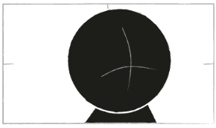
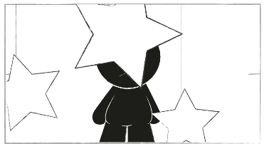
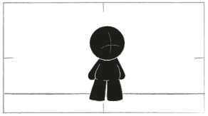
Film your review!
Is it interesting for the audience? Are there any bits you need to take out? How can you improve it?
Experiment! How could you use different camera shots, angles and locations to make it more interesting to watch?
CLOSE UP
CAMERA POSITIONING
LONG SHOT
Notes:
Display slides 10 to 14 to explore things you should consider before you start filming.

Slide 10
Camera positioning
Where is the best place to position the camera to get a clear shot?

Slide 11
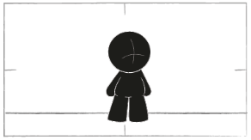
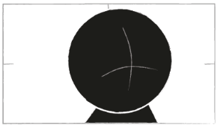
Camera framing
Would a long shot or close up suit best for the activity you have in mind?
LONG SHOT
CLOSE UP

Slide 12
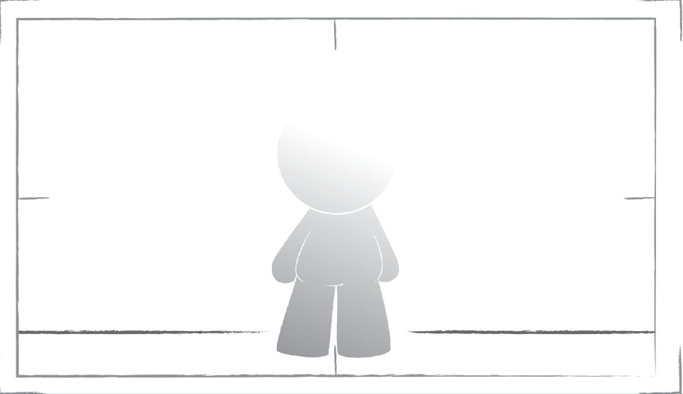
Lighting
Are the people being filmed facing the light source rather than standing with their backs to it?

Slide 13
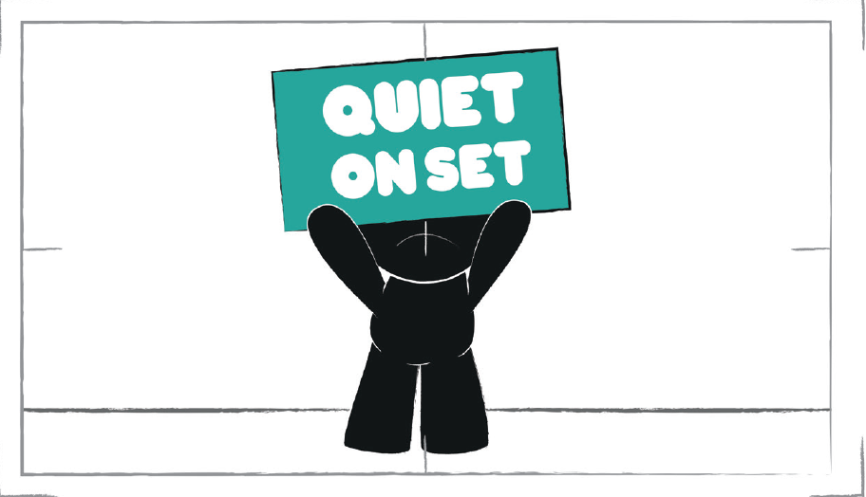
Sound
Have you chosen a suitable location to cut out background noise?
Is the mic close to the person who is speaking to camera?

Slide 14
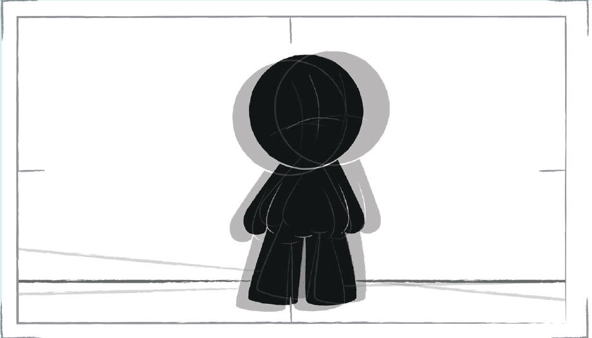
Use of a tripod
If you are without access to a tripod, have you minimised camera shake with your elbows on a table, shelf or wall?

Slide 15
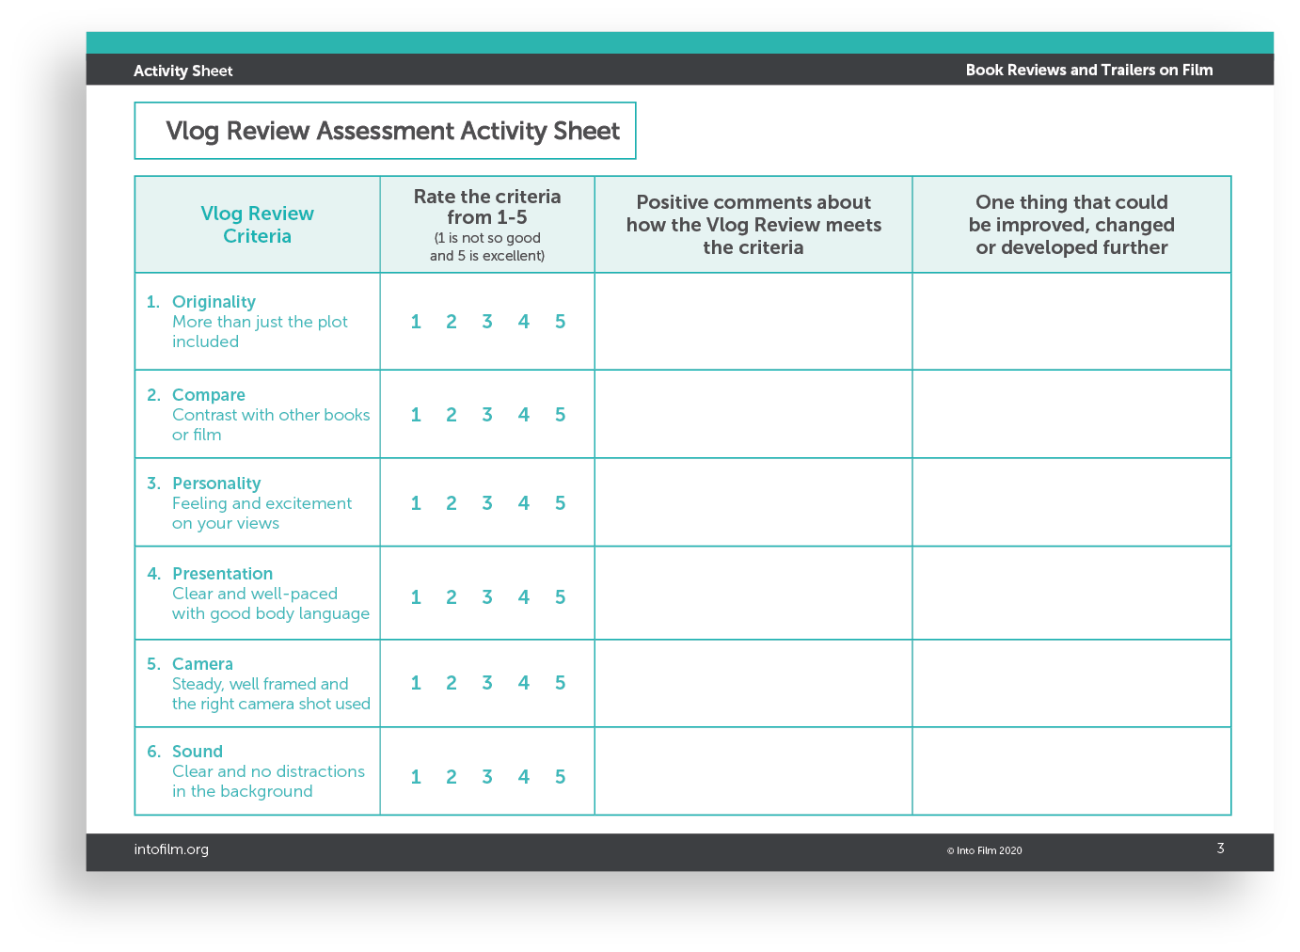
Assess your review
Well done on completing your filmed review!
Use the Vlog Review Assessment activity sheet (next slide) to either self assess or peer assess.
Take into account the areas you could improve and try it again.
How did it look? Was it improved?
Perhaps try it again with a different book to review?

Slide 16
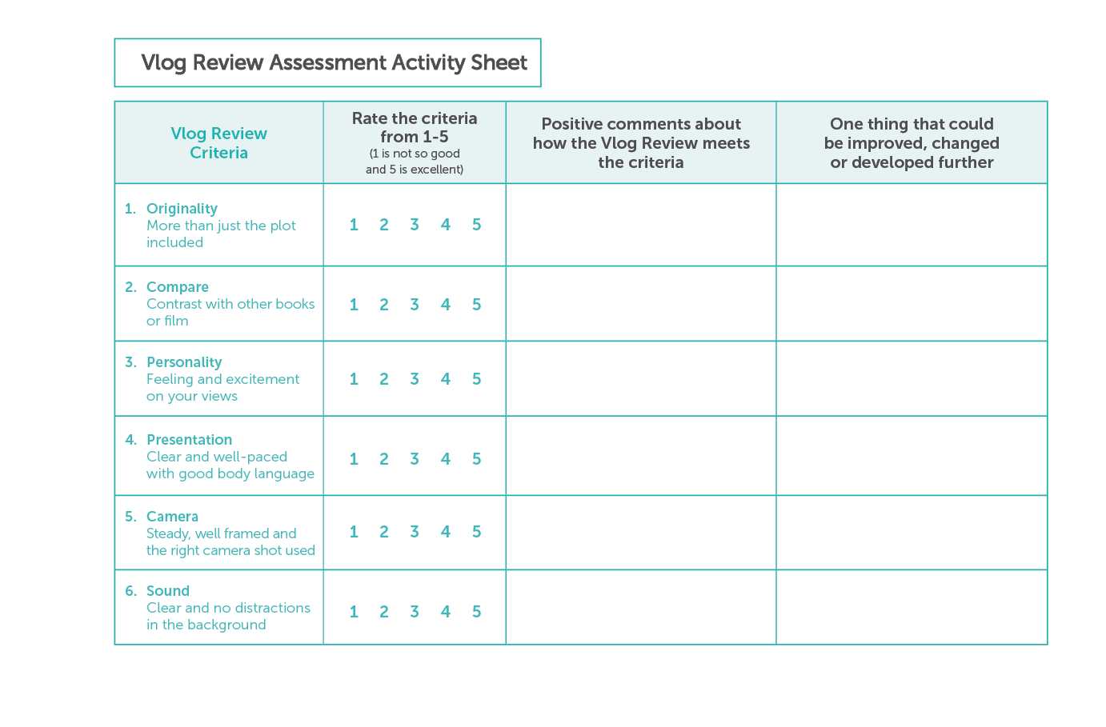

Slide 17
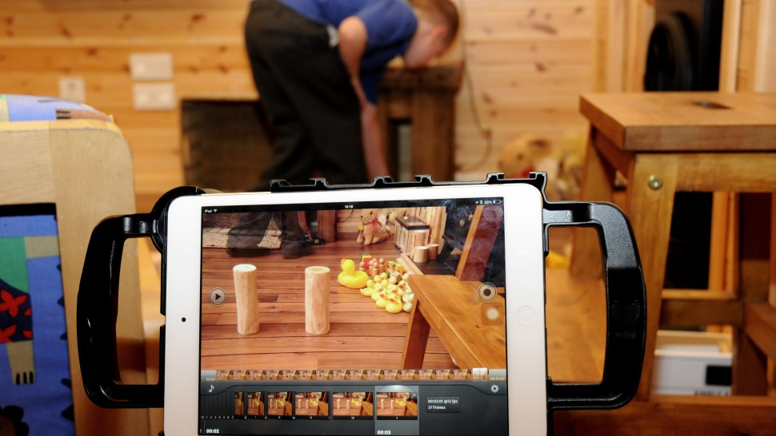
Activity 2: Book Trailers
Notes:
This activity relates to slides 17 to 26 in this PowerPoint presentation and should take around 180 minutes to complete
LEARNING OBJECTIVES:
• To understand how trailers persuade people
• To plan and film a persuasive book trailer
YOU WILL NEED:
Film Trailer Structure on slide 22 or PDF page 5
Storyboard template on slide 25 or PDF page 6
Top 5 filmmaking tips on slides 10 to14 or PDF page 4
3Cs and 3Ss worksheet on PDF page 7-8
Camera shots sheet on slide 26 or PDF page 9

Slide 18
Talk about it, think about it
How do authors and publishers get people interested in reading their books?
How do filmmakers get people to go
and watch their films?
Notes:
Some potential suggestions:
Posters and billboards on buses, and in libraries
Adverts in newspapers and magazines
TV adverts
Book trailers online
Online adverts and pop-ups
2. Filmmakers tend to use film trailers to give a sneak peek at exciting or intriguing content from the film.

Slide 19
Watch the following trailer very carefully
1. What information does the trailer give you about the
story?
setting?
character?
2. Would you want to see this film in the cinema?
Please give reasons for your answer.
Notes:
You can use the 3Cs and 3Ss literacy tool to prompt more discussion.
The 3Cs (colour, camera, character) and the 3Ss, (story, setting, sound) can be used to help students discuss and analyse all the elements of a film text. Working with the 3Cs and 3Ss enables students to make connections between the features of all texts, and develop their decoding, encoding, reading and writing skills.
After viewing a film sequence, just roll the dice and ask your students one of the corresponding questions. Students can become skilled at leading this activity for themselves as a starter activity or plenary for film text analysis.
Some suggested responses to the clip are in the notes on the next slide.

Slide 20
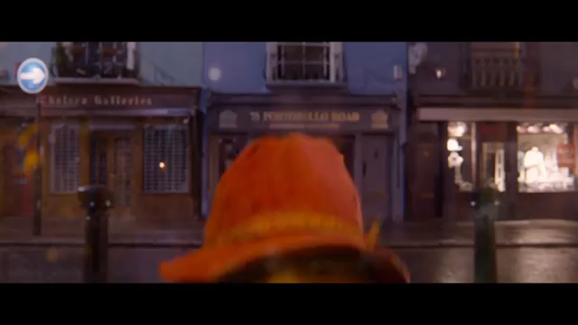
Paddington 2 film trailer
Paddington 2 copyright Studio Canal (2017) All rights reserved
Notes:
Story
Paddington sees a pop-up book about London that he would like to buy for his Aunt Lucy. He gets a range of jobs to try and save up to buy the book. However the book is stolen by Phoenix Buchanan, an actor/ magician/ master of disguise. Paddington tries to catch him but is arrested and jailed for theft. He and the Brown family try to get the book back to Mr Gruber, the bookstore owner.
Setting
The film is set in London and in various locations including shops, the fair, jail, trains and homes.
Character
The main character is Paddington who is the hero . The villain of the film is Phoenix Buchanan. Other characters include the Brown family, Paddington’s fellow prisoners and Mr Gruber

Slide 21
Watch the trailer again
Take note about how is the trailer structured to encourage you to want to see the film?
Fill in what you see and hear in the middle column on the Film trailer structure activity sheet (next slide)
What changes would have to be made to produce a book trailer?
Notes:
You may wish to watch the clip more than once to give more opportunity for analysis. Use the Film trailer structure activity sheet to take note of any observations.

Slide 22
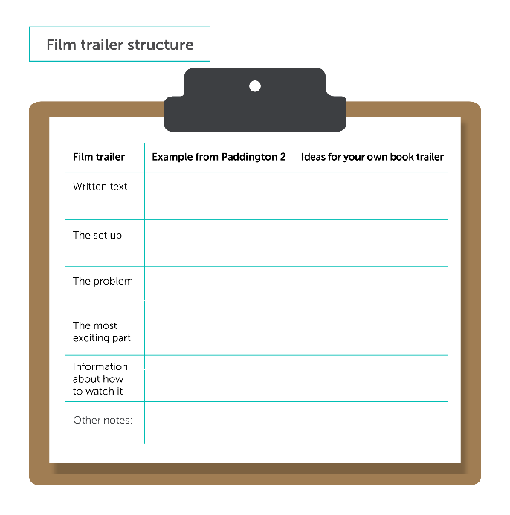
Notes:
Watch the Paddington 2 film trailer and complete only the middle column of the Film trailer structure activity sheet. Discuss any observations. Explain you will now watch a student made book trailer to think about any ideas they can use for their book trailer.

Slide 23

Student made book trailer example
Notes:
This is an example of a pupil made book trailer. You can
discuss the structure of this trailer considering the questions on the
film trailer structure on slide 22. What did they like, is there anything they would
do differently?

Slide 24
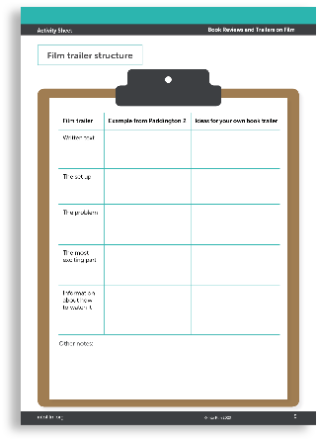
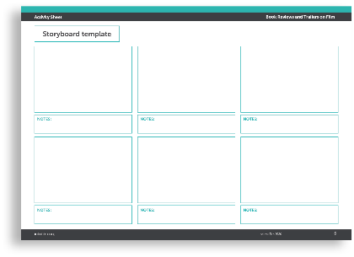
Planning your book trailer
Fill in the ‘ideas for your own book trailer’ column on your copy of the Film trailer structure activity sheet.
You can also create a storyboard (on the next slide) to remind you of your shots when you film your trailer.
Notes:
Looking at the Film Trailer Structure activity sheet on slide 21 fill in the ideas for your own book trailer column.
The book trailer could be for an imagined book by the young person they want to write, publish and promote, or alternatively it could be a trailer of an existing book.
Look at slides 25 and 26 for activity sheets to help plan the book trailer film.
You can also check out this How to Storyboard guide available on the Into Film Shorts YouTube channel https://www.youtube.com/watch?v=Rkk2UzY4US8&list=PLX-ZmzC0Reyzkz1nwxR5BRBI_XJW51PxL&index=2

Slide 25
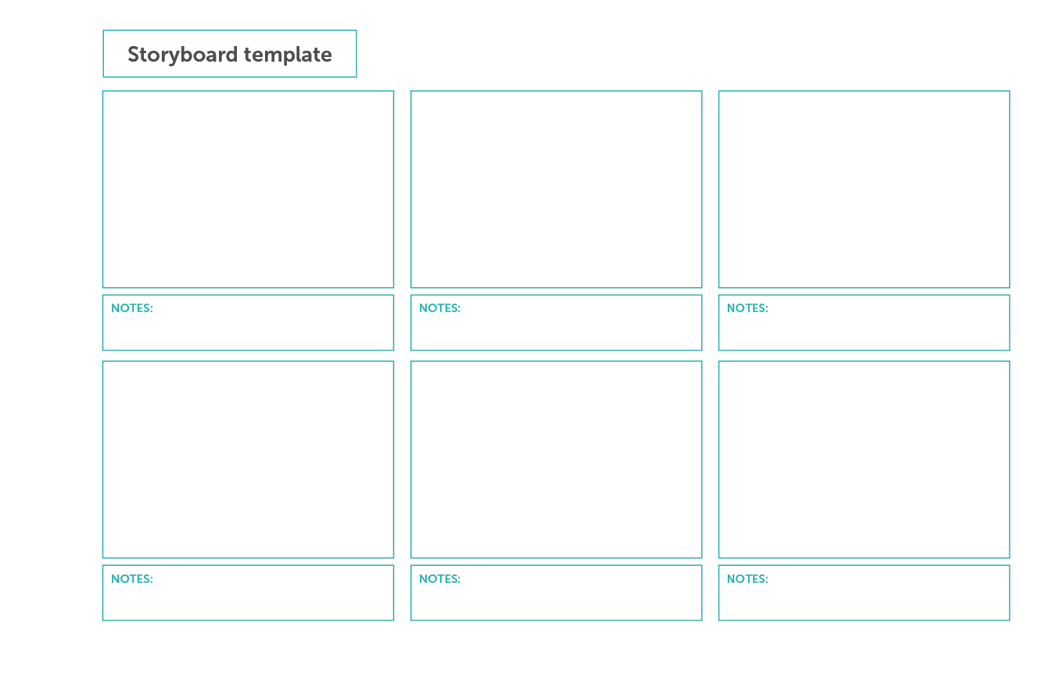
Notes:
Print this or create your own storyboard using a bank or business card to create your frames. Refer to the Camera Shot activity sheet on slide 26 to help plan all your shots before you start to shoot your film.
Check out this How to Storyboard guide available on the Into Film Shorts YouTube channel https://www.youtube.com/watch?v=Rkk2UzY4US8&list=PLX-ZmzC0Reyzkz1nwxR5BRBI_XJW51PxL&index=2

Slide 26
